Slide 1

Nucleosome positioning
Răzvan V. Chereji
Eunice Kennedy Shriver
National Institute of Child Health and Human Development
CONICET
November 23, 2018
Buenos Aires, Argentina

Slide 2
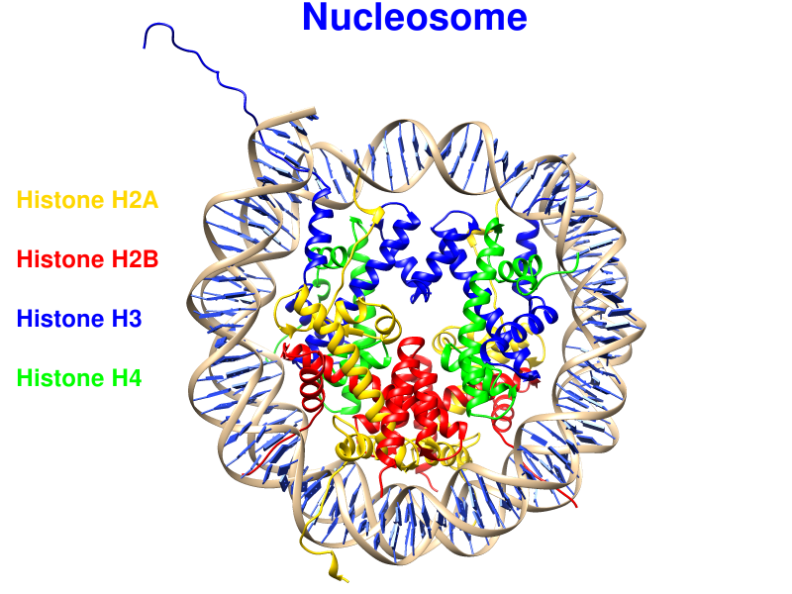
Nucleosome – the basic unit of DNA packaging
Notes:
Nucleosomes are the basic units of DNA packaging. They contain 147 bp of DNA wrapped in about 2 turns around a histone octamer. Nucleosomal DNA is occluded from interacting with many other DNA-binding proteins so their positions affect all DNA-related processes in the cell: transcription, DNA replication, DNA repair, etc.

Slide 3
Nucleosome mapping
Notes:
Because of that we want to identify the precise positions of nucleosomes on the whole genome. But how can we do this?

Slide 4
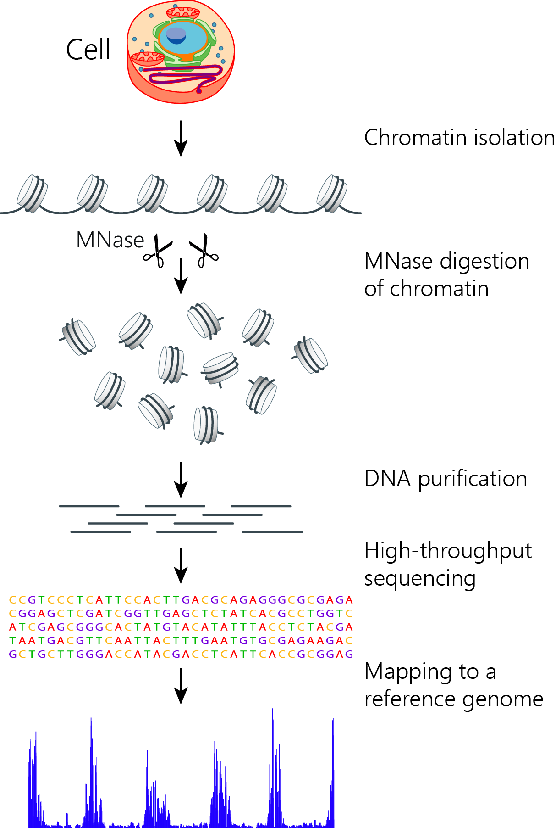
Nucleosome mapping: MNase-Seq
Micrococcal nuclease (MNase): endo-exonuclease
Notes:
The most used method of mapping nucleosome positions is called MNase-seq. Briefly, these are the typical steps of an MNase-seq experiment. First, chromatin is isolated from the cells and digested with micrococcal nuclease (or MNase), which destroys the linker DNA between nucleosomes. Then the undigested DNA is purified, sequenced, and mapped to the genome.
In this workshop we will discuss the last part of this process, that contains the computational steps.

Slide 5
Nucleosome mapping: MNase-Seq
Notes:
So, we start with the undigested DNA

Slide 6
Nucleosome mapping: MNase-Seq
Notes:
Sequencing adapters are added to these fragments.

Slide 7
Nucleosome mapping: MNase-Seq
Notes:
Then the sequencer reads the two ends of each DNA fragment (paired-reads).

Slide 8
Nucleosome mapping: MNase-Seq
Notes:
So we obtain two sets of short reads stored in fastq files (*_R1.fastq, *_R2.fastq).

Slide 9
Nucleosome mapping: MNase-Seq
Notes:
By aligning these short reads to the reference genome, we are able to reconstruct the full DNA fragment between each pair of sequenced reads, and to obtain the genomic position of each nucleosome.

Slide 10
Let’s see now how we can do this.

